Slide 1

Retentive network
А successor to transformer for large language models?
Militsa ivanova

Slide 2
The most common architectures used for llms
Recurrent Neural Network (RNN)
Transformer
RetNets

Slide 3
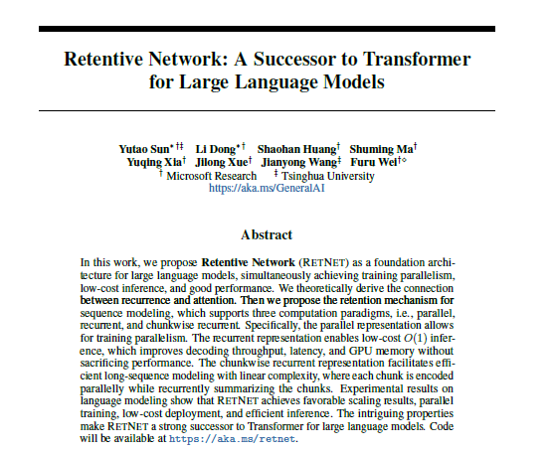
What is a retentive network?
9 August 2023
https://doi.org/10.48550/arXiv.2307.08621

Slide 4

Introduction to Rnns (Recurrent neural networks)
RNNs are designed to handle sequences of data by having loops within them, allowing information to persist
Sequential data processing, memory of previous inputs in the sequence
Use cases: Text generation, speech recognition, language modeling
Vanishing Gradient Problem: it becomes difficult to learn and adjust weights for long sequences -> LSTMs (gating mechanisms)
Difficulty with Long-term Dependencies: Challenges in retaining information from the beginning of a long sequence
Computational intensity: Sequential computation hinders parallel processing

Slide 5
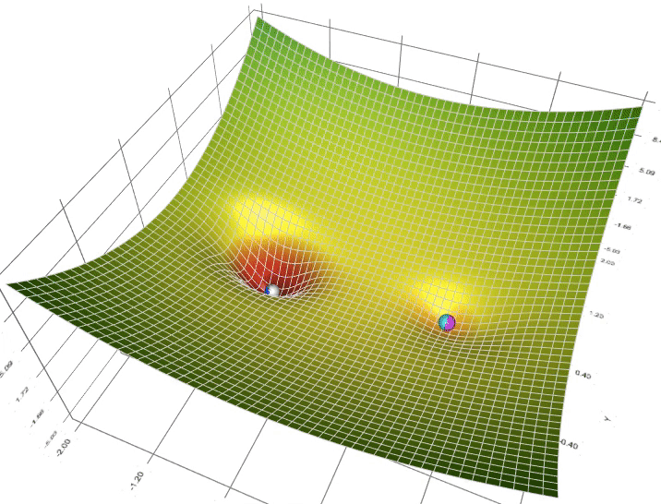
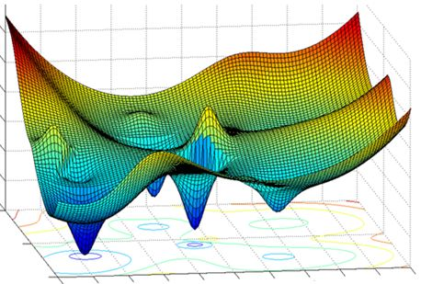
Gradient descent
Notes:
Vanishing Gradients
What Happens: The magnitude of gradients decreases exponentially as they are propagated back through the network's layers during the training process. This occurs especially when using certain activation functions, like sigmoid or tanh, which squash their input into a very small output range in a very non-linear fashion.
Consequence: When gradients vanish, the weights of the early layers in the network barely get updated, meaning these layers learn very slowly, if at all. This makes it difficult to train deep networks effectively, as the signal that adjusts the network's weights becomes weaker and weaker the further back it has to go.
Exploding Gradients
What Happens: The magnitude of gradients increases exponentially during backpropagation. This is more likely to happen with deep networks and certain types of recurrent networks, where repeated multiplication of large weights can lead to very large gradients.
Consequence: Exploding gradients can cause learning to diverge, as weight updates become so large that the network fails to converge towards a minimum of the loss function. In practice, this might manifest as NaN (Not a Number) values for weights or loss due to numerical overflow, making the model unusable.

Slide 6

Introduction to transformers
A model architecture that avoids recurrence and relies entirely on attention mechanisms to draw global dependencies between input and output
Parallel processing capabilities
Scalability: Ability to process long sequences more efficiently than RNNs
SOTA results in NLP tasks like translation, summarization and text generation
High computational and memory requirements – high inference cost
Data Hunger: Requires large amounts of data to perform well

Slide 7
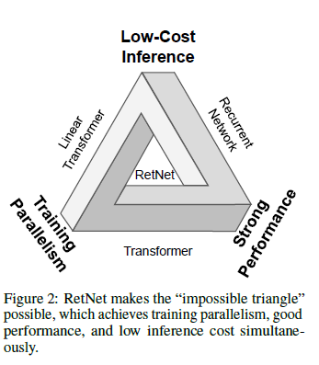

What is a retentive network?
Training parallelism- distributing the process of training a model across multiple computing resources, such as GPUs or CPUs, simultaneously
Inference- involves applying the model to input data to generate outputs

Slide 8
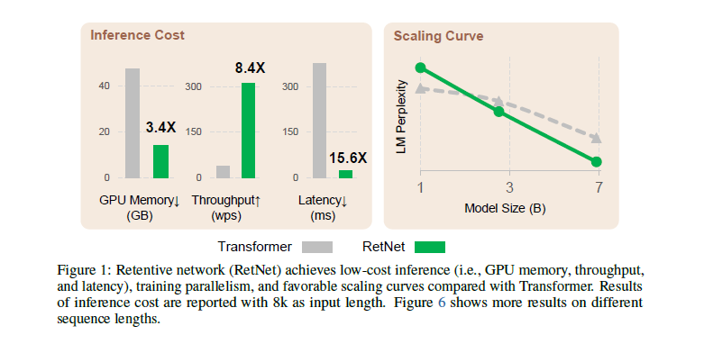
What is a retentive network?
Throughput- the amount of work a system can complete within a second
Latency- the time it takes a model to start producing and answer after receiving an input
LM Perplexity – how well a language model predicts a sample; lower values indicate a better performance

Slide 9

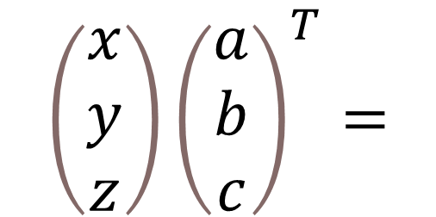
Understanding the math behind everything
ax + by + cz =
ax -> γ
by + γ -> γ
cz + γ -> γ
γ =
$$\left(\begin{matrix}x \\ y \\ z\end{matrix}\right){\left(\begin{matrix}a \\ b \\ c\end{matrix}\right)}^{T}=$$
Sequential representation
Parallel representation

Slide 10
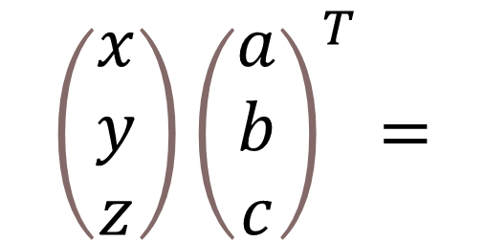
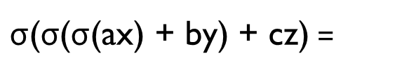
Understanding the math behind everything
$\text{σ}\text{(}\text{σ}$(σ(ax) + by) + cz) =
The memory is filled with the buffer and the future operations depend on the previous ones
$$\left(\begin{matrix}x \\ y \\ z\end{matrix}\right){\left(\begin{matrix}a \\ b \\ c\end{matrix}\right)}^{T}=$$
The memory is filled with all the dot products, which are calculated simultaneously, and then
we sum them

Slide 11
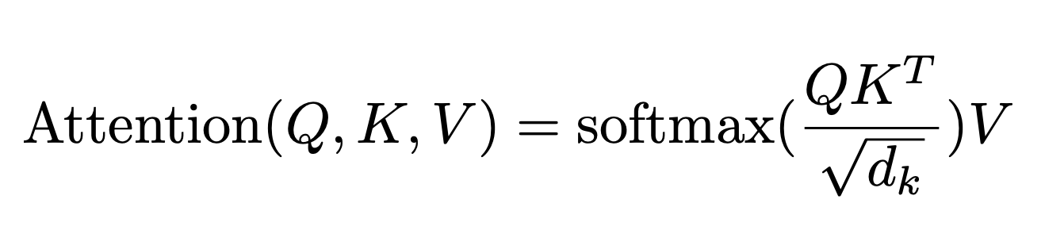
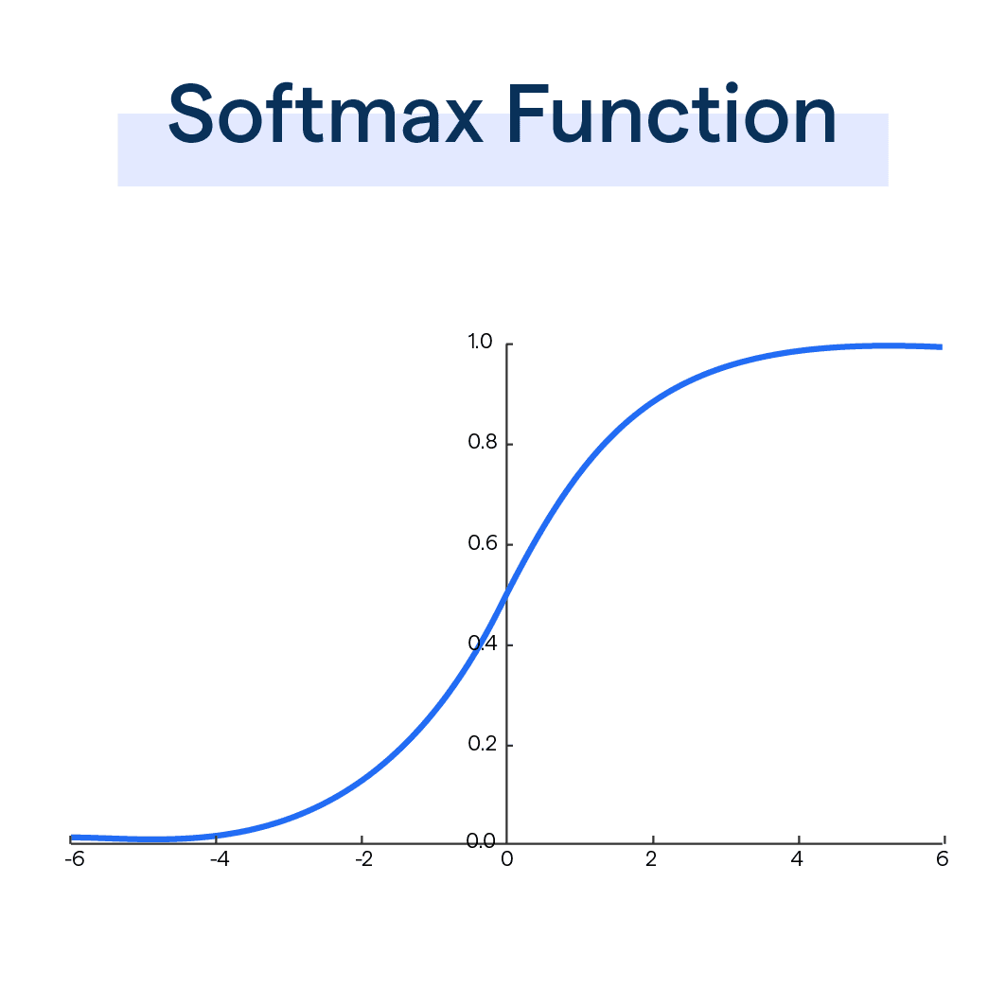
Understanding the math behind everything
Why can’t a Transformer be written recurrently?
It would lose the ability to process the entire input sequence in parallel
The self-attention mechanism of Transformers allows each position in the sequence to directly attend to every other position, regardless of distance, enabling the model to learn relationships between distant elements effectively
Why do we use Softmax?
Attention weights
Probability distribution
Stabilizing Gradients
Notes:
In the attention mechanism of a Transformer model, the keys, queries, and values work together like this: The model compares each query with all the keys to see how relevant they are to the query. This comparison produces attention scores, indicating how much focus should be placed on each key. Then, these attention scores are used to weigh the corresponding values. Finally, the weighted values are combined to produce the output.
Q: This is the matrix of queries. In the context of the Transformer, each query corresponds to an element (such as a word or token) that is seeking to find out which keys (elements) to focus on.
K: This is the matrix of keys. Each key is associated with an element in the sequence, and the compatibility of a query with a key determines how much attention the query will pay to the corresponding value.
V: This is the matrix of values. Once the attention scores between the queries and keys are established, these scores are used to weigh the values. The result is a weighted sum of values, where the weights are the attention scores.
QKT: The product of the query matrix and the transpose of the key matrix. This operation gives you a score matrix where each element represents the dot product between a query and a key, effectively measuring the compatibility or relevance between each pair of query and key.
dk​​: The dimensionality of the key vectors, dk​, is used to scale the dot product result. This scaling factor helps in stabilizing the gradients during training, as without scaling, the dot product could grow large in magnitude pushing the softmax function into regions where it has extremely small gradients (since the softmax function would be operating in the saturation regime).
softmax(): The softmax function is applied to each row of the score matrix obtained from QKT, which turns the scores into probabilities. The softmax is calculated row-wise, so for each query, you get a probability distribution across all keys. This represents how much each query attends to each key.
The final multiplication with V: The attention scores (after softmax) are then used to create a weighted sum of the values, so each element in the output matrix is a sum of the values, weighted by the attention probabilities. This output represents the input sequence where each element is now a combination of its own information and the information it attended to from the rest of the sequence.
In simpler terms, you can think of keys as clues, queries as questions, and values as the information you're looking for. The model uses these clues and questions to find and understand the relevant information in the input data.
For example, when you search for videos on Youtube, the search engine will map your query (text in the search bar) against a set of keys (video title, description, etc.) associated with candidate videos in their database, then present you the best-matched videos (values).
Softmax is used to convert the raw attention scores, often called “logits,” into a probability distribution over the input tokens. This distribution assigns higher attention weights to more relevant tokens and lower weights to less relevant ones.
Softmax ensures that the attention scores are transformed into a valid probability distribution, with all values between 0 and 1 and the sum equal to 1. This property is important for correctly weighing the input tokens while taking into account their relative importance.

Slide 12
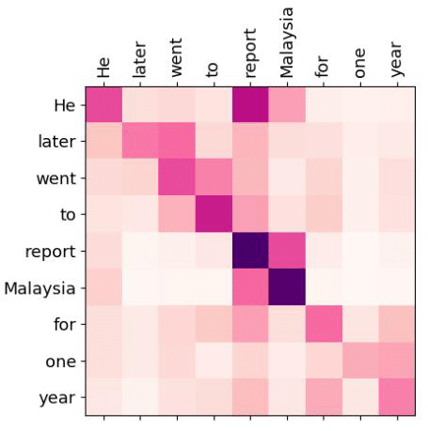
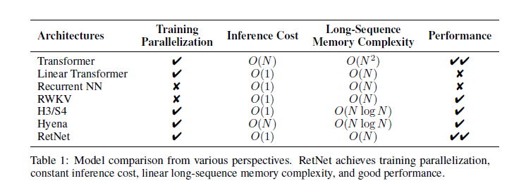
Understanding the math behind everything
Then why are Transformers so inefficient when it comes to inference?
Notes:
During inference, a Transformer model processes the input sequence in a series of steps that is proportional to the length of the sequence.
The notation O(1) for RNN inference cost isn't typically accurate. Instead, RNNs have a per-step computation cost of O(1) because, at each time step, the computation required to process a single input and update the hidden state is constant, regardless of the sequence length. However, this is on a per-step basis. When you consider the entire sequence of length N, the inference cost adds up linearly, making the overall computational complexity for one pass through an input sequence O(N), where N is the sequence length.

Slide 13
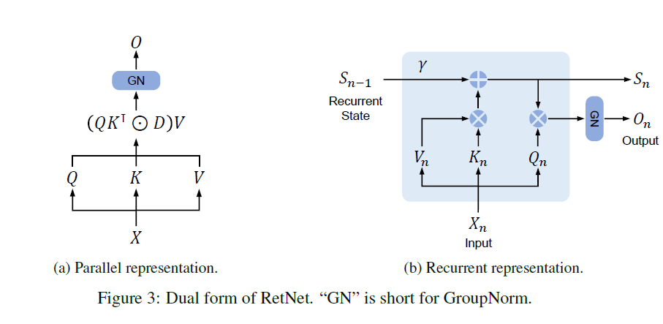
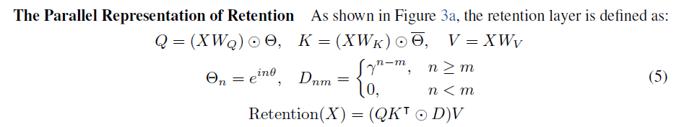
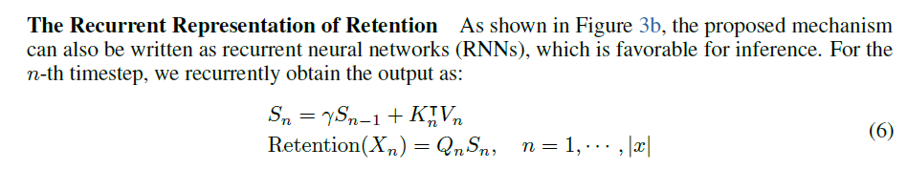
Parallel vs recurrent representation

Slide 14
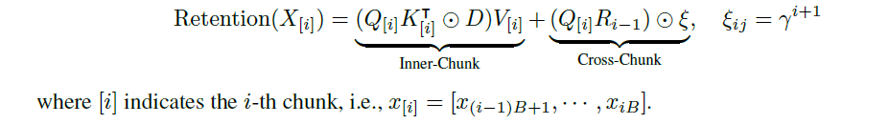
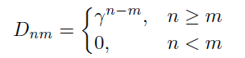
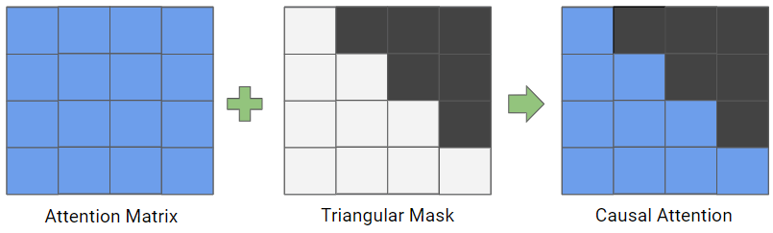
Understanding the math behind everything
Interpretation: We compute the “current” chunk in parallel (Inner-Chunk) and accumulate the “distant” past into the R-buffer (Cross-Chunk). The causal mask has a time-decay scalar: the further back a token is, the more its effect decays in the causal mask.
Q – query
K – key
V - value
D – causal mask
R – buffer
γ - scalar
Notes:
Causal Mask Functionality: BLOCKING THE INFLUENCE FROM FUTURE TOKENS
Preserving Autoregressive Property: The causal mask ensures that during the self-attention computation, a token only attends to itself and the tokens that have been generated before it. This mimics the process of generating text one word at a time, where the model doesn't have access to future words.
Triangular Structure: Technically, the causal mask is a triangular matrix filled with zeros in and below the diagonal (inclusive) and negative infinities (or a very large negative number) in the upper triangle. During the softmax step of the attention mechanism, any position with negative infinity effectively gets an attention score of zero after the softmax is applied, thereby blocking any influence from future tokens.

Slide 15
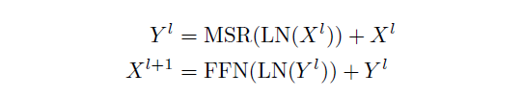
Architecture
MSR- multi-scale retention
Those are different retention heads in each layer with different γ for each head.
Output
LN
FFN
GroupNorm
Residuals
MSR
LayerNorm
X
Notes:
Multi-head attention is a feature of the Transformer architecture that allows the model to jointly attend to information from different representation subspaces at different positions. Essentially, it's a way to run several independent attention mechanisms (the "heads") in parallel.
Multi-Head Attention Process:
Parallel Operations: The attention mechanism is run in parallel across the multiple heads, allowing the model to capture different types of information simultaneously.
Concatenation: The outputs of all heads are then concatenated into a single matrix. This concatenation allows the Transformer to combine the different learned aspects into a complex representation.
Final Linear Projection: The concatenated matrix is then linearly projected once more with another learned weight matrix, resulting in the final output of the multi-head attention block.
The multi-head attention mechanism allows the Transformer to focus on different parts of the input sequence differently, which is more flexible and powerful than a single set of attention weights. By expanding the model's capacity to focus on various features and relationships in the input data, multi-head attention helps the Transformer to achieve impressive performance across a wide range of tasks in natural language processing and beyond.
The idea of residuals, or residual connections, in architectures like ResNet (Residual Networks) and Transformers is to allow the direct flow of information across layers without obstruction. This concept is a response to the problems encountered when training very deep neural networks, such as vanishing or exploding gradients which make it difficult for models to converge.

Slide 16
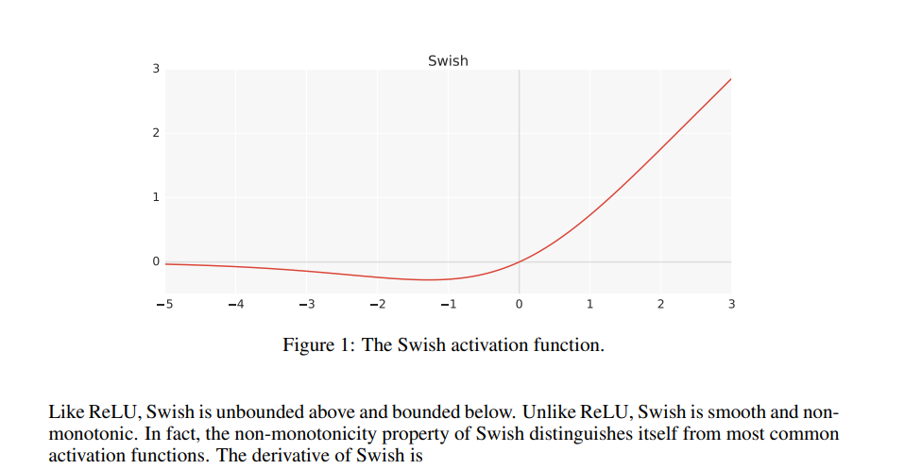
Architecture
MSR- multi-scale retention
Those are different retention heads in each layer with different γ for each head.
Output
LN
FFN
GroupNorm
Residuals
MSR
LayerNorm
X
Notes:
Multi-head attention is a feature of the Transformer architecture that allows the model to jointly attend to information from different representation subspaces at different positions. Essentially, it's a way to run several independent attention mechanisms (the "heads") in parallel.
Multi-Head Attention Process:
Parallel Operations: The attention mechanism is run in parallel across the multiple heads, allowing the model to capture different types of information simultaneously.
Concatenation: The outputs of all heads are then concatenated into a single matrix. This concatenation allows the Transformer to combine the different learned aspects into a complex representation.
Final Linear Projection: The concatenated matrix is then linearly projected once more with another learned weight matrix, resulting in the final output of the multi-head attention block.
The multi-head attention mechanism allows the Transformer to focus on different parts of the input sequence differently, which is more flexible and powerful than a single set of attention weights. By expanding the model's capacity to focus on various features and relationships in the input data, multi-head attention helps the Transformer to achieve impressive performance across a wide range of tasks in natural language processing and beyond.
The idea of residuals, or residual connections, in architectures like ResNet (Residual Networks) and Transformers is to allow the direct flow of information across layers without obstruction. This concept is a response to the problems encountered when training very deep neural networks, such as vanishing or exploding gradients which make it difficult for models to converge.

Slide 17
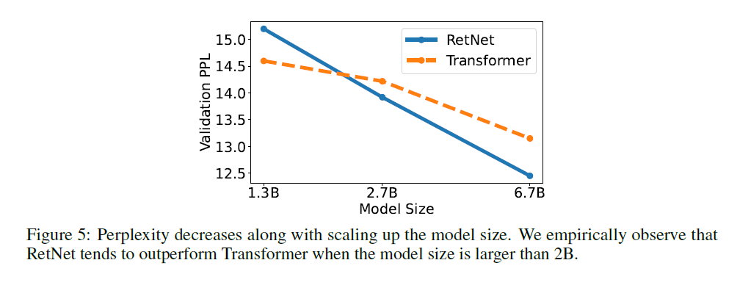
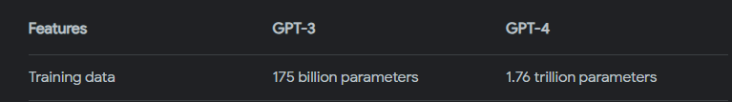
Experiments

Slide 18
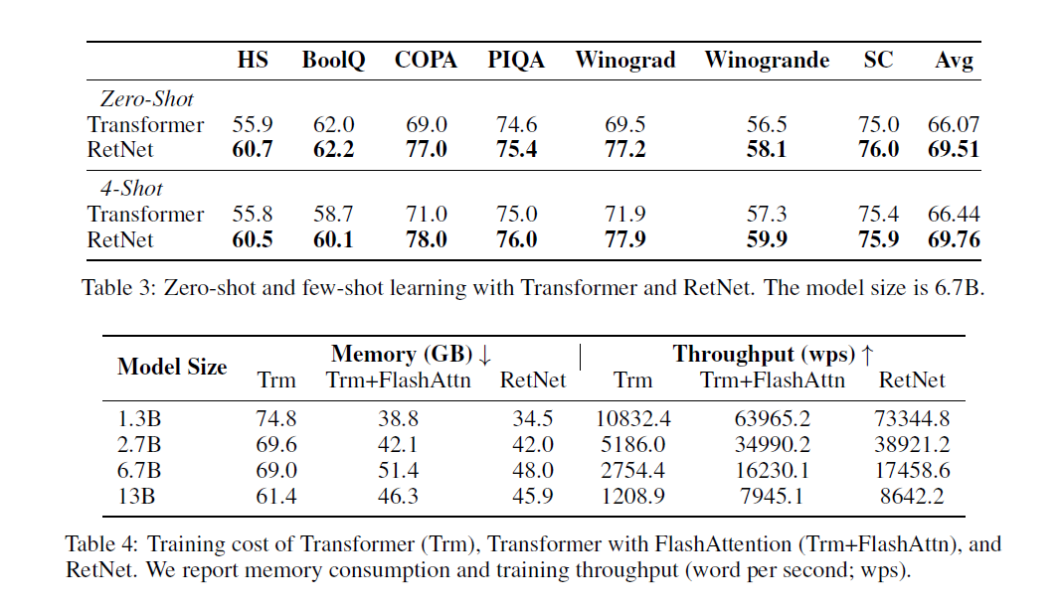
Experiments: Comparison with the Transformer

Slide 19
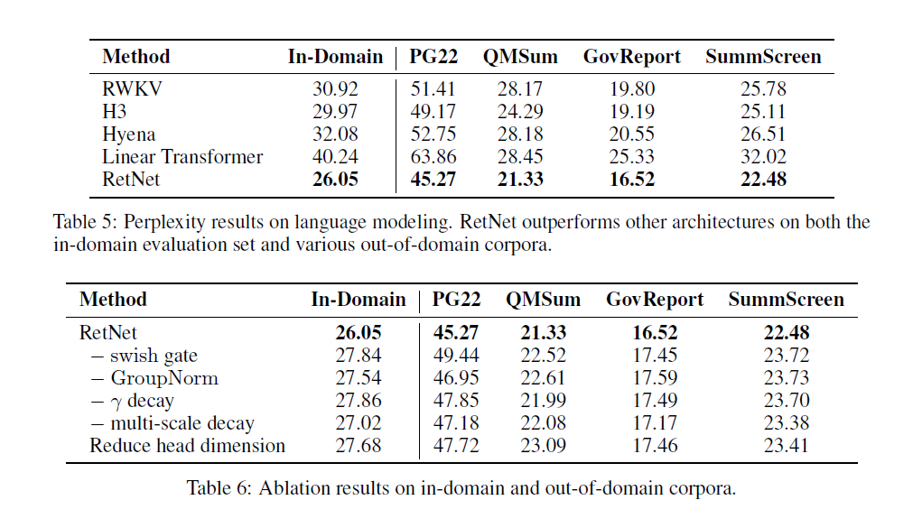
Experiments: Comparison with Transformer Variants
Notes:
An in-domain evaluation set is a collection of data that is drawn from the same distribution as the training data. It closely matches the type of content and scenarios the model was trained on.
If you have a language model trained on scientific literature, an in-domain evaluation set might consist of new, unseen scientific papers or articles that are stylistically and contextually similar to the training corpus.
Out-of-domain corpora consist of data that is different in some significant way from the training data. It might differ in style, content, genre, or time period, among other factors.

Slide 20


Research questions
How well does RetNet perform on different data?
Is it worse than Transformers when compared on a smaller/bigger scale?
Is RetNet faster and more efficient?

Slide 21

Thank You
Militsa Ivanova

